Slide 1
Smart Office

Slide 2
Smart Office
What is this?
Why use it?
How to use it?

Slide 3
What is this?

Slide 4
Why use it?

Slide 5
How to use it?

Slide 6
Topics:
Smart door
fire detector
Rain detector
Solar energy
Controlling of these devices

Slide 7
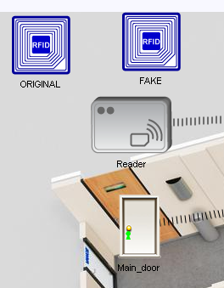
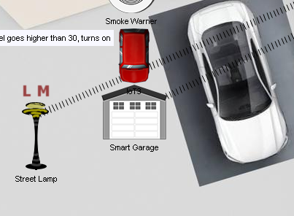
Smart door

Slide 8
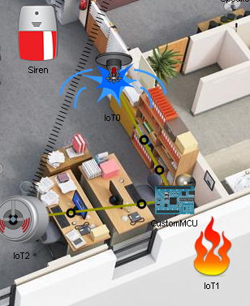
Fire detector

Slide 9
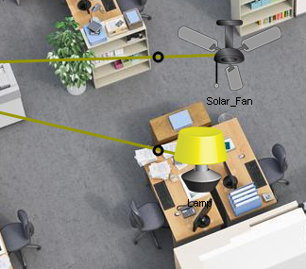
Lighting and cooling

Slide 10
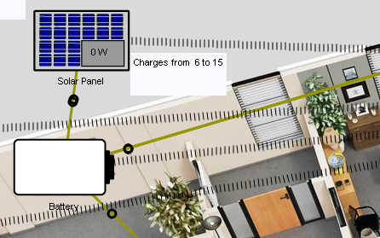
Solar energy

Slide 11
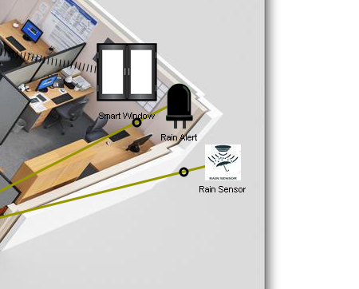
Rain detector

Slide 12
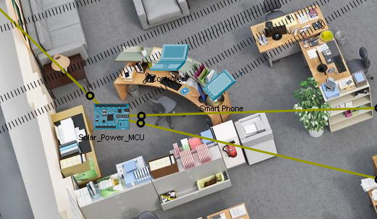
controlling

Slide 13
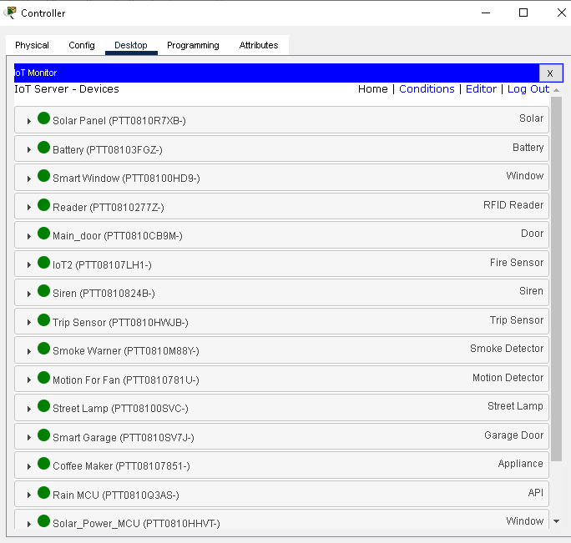
monitoring

Slide 14
Smart Grid

Slide 15
Smart Grid
What is this?
Why use it?
How to use it?

Slide 16
What is this?

Slide 17
Why use it?

Slide 18
How to use it?

Slide 19
Different power sources:
Wind power
Solar power
Coal power

Slide 20
components
Wind turbine and wind meter
Solar cells and solar meter
Coal power plant and coal meter
Power access point
Smart power grid switch

Slide 21
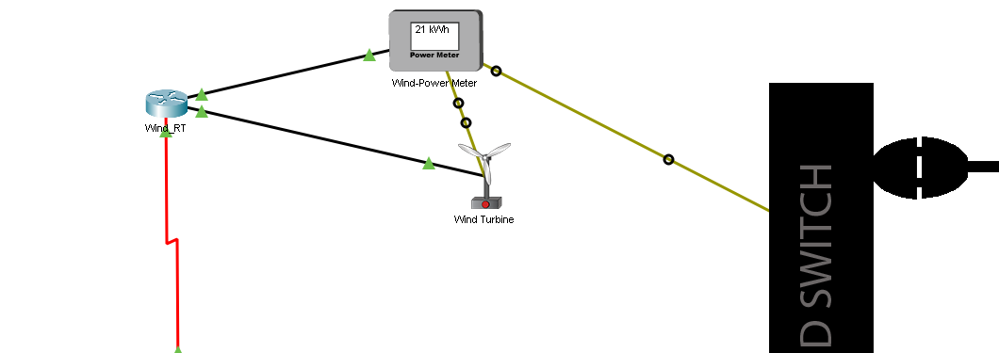
Wind power

Slide 22
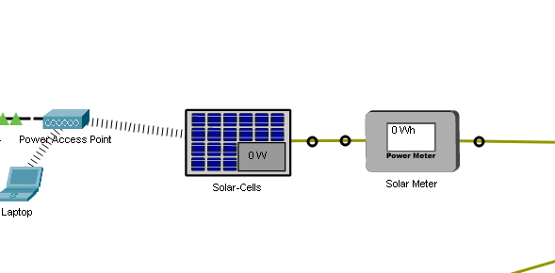
solar power

Slide 23
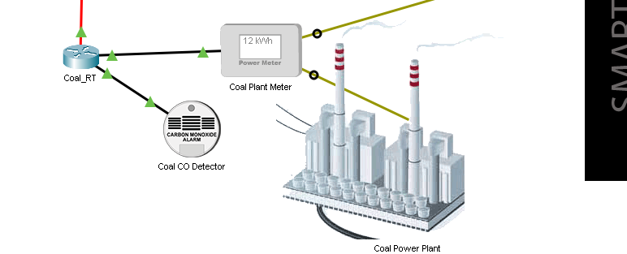
coal power

Slide 24
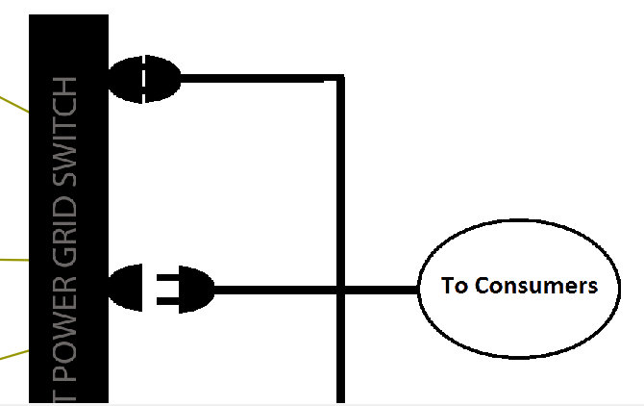
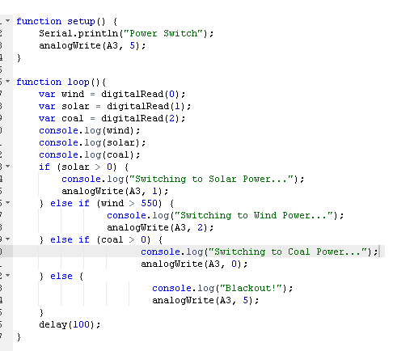
Smart power grid switch

Slide 25
thanks

